Slide 1
Final Presentation
Project Name: Bank Campaign Marketing

Slide 2
Preprocessing
Label encode : Encode the target values
One-hot encode: encoded the categorical values.
Total Number of Features : The features which were used while implementing a model were 16 features.
The target value is highly imbalanced with ratio of 9:1.
To avoid bias in the model due to imbalance data following techniques were applied:
> Assigning weights to minority class
> Applying cross- validation and stratified kfold technique

Slide 3
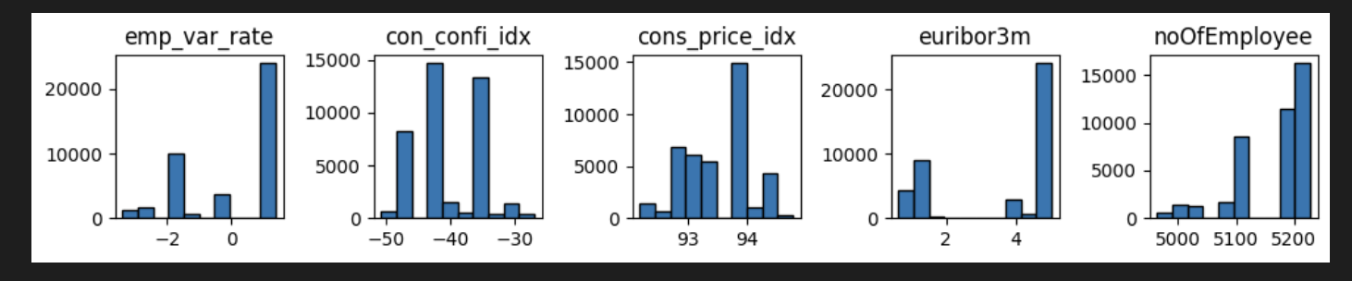
Feature Engineering
There were 4 data features which were irrelevant and creating more bias on the basis of statistical tests and p-value evaluations.
> Employment variation rate (emp_var_rate)
> House Loan
> euribor3m
> Personal Loan

Slide 4
Model Evaluation Matrix
Business Goal: To increase number of people subscribing the deposit scheme product.
Technical : The goal is to improve false positive values to decrease the chances of loosing the vital subscriber.
It can be fulfilled by improving recall score and accuracy must be stable which can help us maintain the prediction quality.

Slide 5
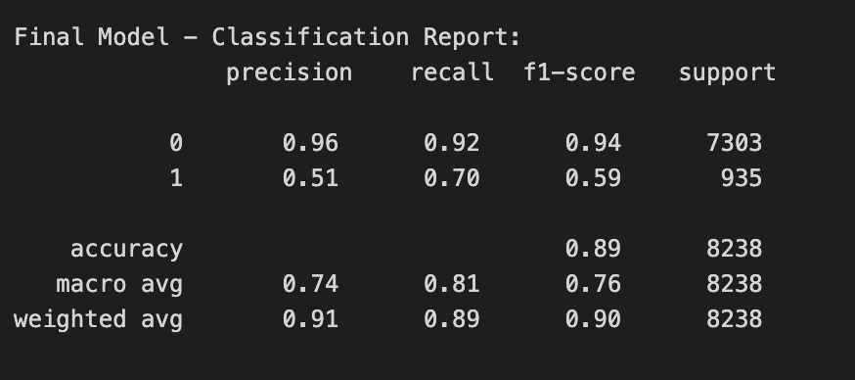
Mode 1: Linear Model
Logistic Regress is one of the simple and effective linear model.
i) Type 1: Assign weights to the target class:
Accuracy : 89% and recall: 70%

Slide 6
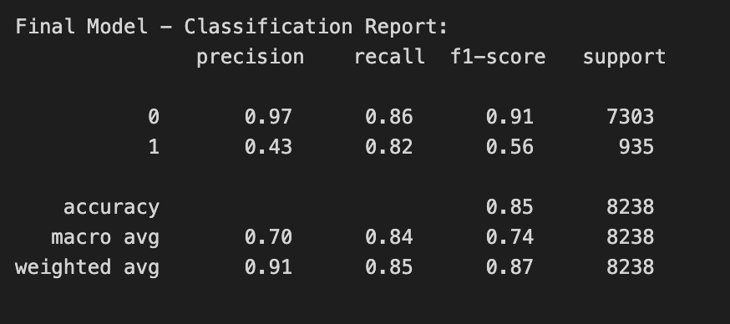
> Type 2 : No weights assigned
Accuracy : 85% and recall: 82%
Low Accuracy and High recall (comparing accuracy and recall with the above model)
Helps in predicting more false positive values which reduces the chances of losing even a vital subscriber.

Slide 7
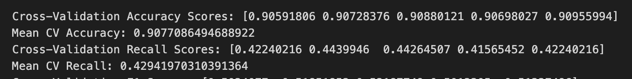
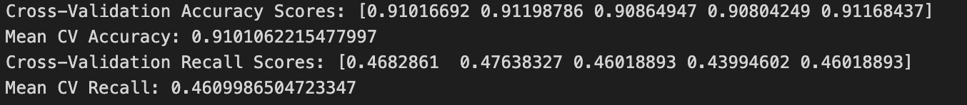
Model 2: Ensemble Method
Random Forest:
> Type 1 : Applied Cross validation and balanced class weights:
Accuracy = 90% and recall = 42.9%
> Type 2 : Applied Cross validation and assigned varied class weights:
Accuracy = 91% and recall = 46%
Observation:
Performs poorly compared to Linear model though the accuracy is higher compared to linear model
As, Recall values are slightly increasing for Type 2 with comparison of Type 1 but it has been worst while comparing with linear model

Slide 8
Model 3: Boosting Method
Light Gradient Boosting:
> Applied Stratified Fold and under sampling the class to balance class:
The Linear Model and Light Gradient model are more reliant and predictive for analyzing people behavior on whether they will subscribe for the product or not?
However, LGB is more efficient and effective in recommending the behavior of people as the accuracy and Recall has been high and significant.

Slide 9
Conclusion
The Ensemble Technique has varied accuracy with different techniques applied on the predicting the target variable, but recall remain the constant.
The Linear Model improved with different techniques and helped the model to predict falser positive to increase the chance of campaigning for more reliable subscriber, but accuracy was being very low.
However, Boosting technique had overall high accuracy and high recall which had made more varied to the business goal and can predict the
Conclusion 1 : Total number of people must be contacted = True Positive + False Positive(If we are focusing on contacting people who were contacted before).
Conclusion 2: Also, It allow us to predict whether the new customer will accept
the product or not!

